Slide 2
Welcome to FinditinBirmingham’s breakfast meeting: Budget Consultation 2016+ with Birmingham City Council
Welcome by Maureen Griffiths
Birmingham City Council

Slide 3
Public consultation
Council Business Plan and Budget
2016+
14 December 2015
Cllr John Clancy
Leader Birmingham City Council

Slide 4
Our vision for the Future Council in 2020
A strong economy
Safety and opportunity for all children
A great future for young people
Prosperity
Fairness
Democracy
Thriving local communities
A healthy, happy population
A modern council

Slide 5
Why we need to change
FUTURE COUNCIL
programme
FINANCIAL
ORGANISATIONAL
We need to save a further c. £250m by 2019/20
We need to adapt to the changing needs of citizens, partners, staff and the city
Notes:
Responding to pressures from Central Government as a result of the national austerity programme
Between 2011 and 2016 the Council has made savings of £567m
Birmingham has to identify savings of c. £306m by 2019/20
£247m of those savings are still to be identified.
These budget reductions also need to be considered alongside a reduction in other public service budgets e.g. West Midlands Police

Slide 6
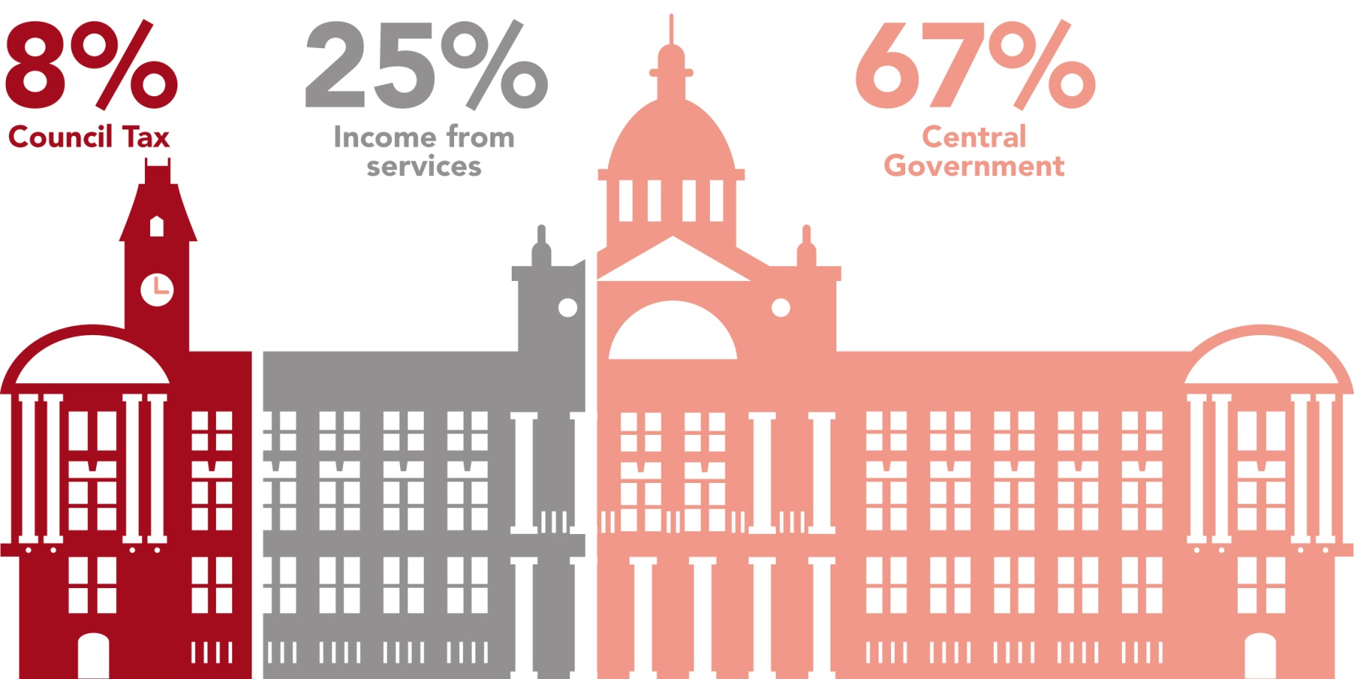
Our income
Our
financial
9%
Council
Tax
27%
Income from local services
64%
Central government
challenge
We need to save a further c£250m by 2019/20

Slide 7
Our spending
Our
financial
Controllable budget
The reduction in the Government corporate grant affects this figure
We also face pressures to spend more on services, for example:
The effects of inflation
The extra costs associated with the National Living Wage
The impact of growing numbers of older people requiring care
Continued investment in children’s social care
challenge
We need to save a further c£250m by 2019/20
£1bn

Slide 8
Our spending
Our
financial
Uncontrollable budget
Some funds can only be spent on certain things – e.g. housing, schools, benefits
Debt charges must be paid
challenge
We need to save a further c£250m by 2019/20
£2.2bn

Slide 9
Our consultation
 | 2016/17 £m | 2017/18 £m | 2018/19 £m | 2019/20 £m
Savings requirement | 90 | 165 | 231 | 258
Savings previously consulted on | 16 | 24 | 31 | 37
Savings now being consulted on | 74 | 141 | 181 | 216
On top of the annual savings of over £560m that the Council has already made from 2010/11 up to 2015/16
A major part of the savings is crucially dependent on making rapid joint progress with Birmingham NHS leaders towards a much larger, more extensive integration and transformation of the City's health and social care system.

Slide 10
Why we need to change
FUTURE COUNCIL
programme
FINANCIAL
ORGANISATIONAL
We need to save a further c. £250m by 2019/20
We need to adapt to the changing needs of citizens, partners, staff and the city
Notes:
Responding to pressures from Central Government as a result of the national austerity programme
Between 2011 and 2016 the Council has made savings of £567m
Birmingham has to identify savings of c. £306m by 2019/20
£247m of those savings are still to be identified.
These budget reductions also need to be considered alongside a reduction in other public service budgets e.g. West Midlands Police

Slide 11
We need to improve our understanding of what drives demand for our services so that we can improve their design and make sure we get things right first time.
Our
organisational
challenge

Slide 12
A new way of working
Focus on long-term independence for citizens, working with the community to design local solutions
Outward looking, community based, working at a regional, city and local level
Our
organisational
challenge
Work closely with our partners, across everything we do
A council that runs less services directly and has to influence others – either in partnership or through contracts
A smaller core council, where staff are out in communities using technology to stay connected with vulnerable customers

Slide 13
Planning for change
Use workshops focused around customer groups to better understand how different people use the whole council in different ways
Identify six major themes where we believe we can reduce cost and deliver better outcomes
Develop a budget and business plan that takes a medium term view

Slide 14
Our themes
Preventing family breakdown
Maximising the independence
of adults
Sustainable neighbourhoods
Economic
growth and jobs
The changing workforce
Council wide
We are also proposing
An increase of 2% each year in Council Tax
To take up the opportunity to raise a “Social Care Precept” by increasing Council Tax by a further 2% each year to provide extra funding to meet costs of social care
Notes:
Rather than salami slicing services to achieve the reduced spend we have to make through the government cuts and budget pressures, we examined how we might reduce the need for or call on services, for example through effective prevention. We analysed what we deliver from a citizen and customer perspective, rather than starting with the services. We generated a large number of ideas which have been grouped under these four themes – preventing family breakdown; maximising independence; sustainable neighbourhoods and growth and jobs.
We also looked a further back office efficiencies and how we plan the workforce in the future. I will just briefly explain these themes and what they mean.

Slide 15
Our themes
Preventing family breakdown
Maximising the independence
of adults
Sustainable neighbourhoods
Economic
growth and jobs
Preventing family breakdown gives children a better chance in life and reduces the need for children and families to enter the social care system
Ultimately, this can reduce demand on social care services and the cost to the council of providing long term support and placements.
Some options
Create more resilient families
Focus on targeted early help to promote resilience and reduce reactive services
Reduce the use of residential care
Reduce the number of care proceedings through better family support
Work with teenagers to prevent family breakdown
Build individual resilience
Supporting parents to be responsible for their children
Focus on young people in care/youth offending, building independence and becoming self-managing
Supporting young people to return to parents where safe
Focus on school attendance and full curriculum for all

Slide 16
Our themes
Preventing family breakdown
Maximising the independence
of adults
Sustainable neighbourhoods
Economic
growth and jobs
Of vulnerable older adults and younger adults with disabilities, mental health issues and people who become homeless
Some of the need/call on services may not be inevitable
It may be prevented or delayed by supporting people in the best way to be more resilient and independent and making sure that they can access the right information when they need it to get help.
Some options
SEND (Special Educational Needs and Disabilities)
Work with families to identify what would help make them and the person with SEND more resilient and independent
Set clearer expectations of a ‘needs-based’ personal budget.
Homelessness
Prevent avoidable entry to the homelessness system and support independence by addressing the key causes and risk factors associated with homelessness
Ensure housing provision is better matched to people’s needs and reduce time spent in temporary accommodation.

Slide 17
Our themes
Preventing family breakdown
Maximising the independence
of adults
Sustainable neighbourhoods
Economic
growth and jobs
Change our behaviours – citizen, communities, organisations, business - to reduce waste and increase recycling rates have direct cost savings for the council
Create a more sustainable environment will reduce costs and is better for the health and wellbeing of us all
We must make sure our services get it right first time before we can expect citizens to change their behaviour.
Some options
Cleaner Streets
Intelligence led approach to street cleansing
More community ownership of cleaner streets
Combination of enforcement, education and community marketing to encourage residents and businesses to keep streets/footpaths tidy
‘Reduce, reuse, recycle’
More recycling
Passing initial cost of bins, waste collection and recycling on to the developers of new estates/house builders
Encouraging customers (households and trade) to bring waste to the council’s designated sites
Reduce failures/failed waste collections

Slide 18
Our themes
Preventing family breakdown
Maximising the independence
of adults
Sustainable neighbourhoods
Economic
growth and jobs
Attract investment to the city
Connect local people with business growth and prosperity
Ensure children and young people get the best start in life from pre-school to leaving school, including those most vulnerable.
Some options
Education and skills
Embed the Youth Promise to improve careers advice and guidance and develop clear progression pathways.
Seek out efficiencies through review of PFI project, contracts, trading services, sponsorship and CSR.
Arts and culture
Create a more balanced financial strategy for arts and culture shaped and funded by a wider range of partners and stakeholders.
Continue to work to make Library of Birmingham a credible and viable service offer in partnership with others.

Slide 19
What happens next?
9 Dec
Publish 2016+ budget white paper and launch consultation process
8 Jan
Consultation closes
1 Mar
Full Council considers Business Plan and Budget
Dec 2015
Jan 2016
Feb 2016
Mar 2016
16 Feb
Cabinet considers Business Plan and Budget
15 & 16 Dec Public meetings
6 Jan Public meeting

Slide 20
Have your say
Online survey: www.birminghambeheard.org.uk
Email: budget.views@birmingham.gov.uk
Text: 07786 200 403 - start with ‘Budget’
Twitter: #brumbudget16
Birmingham Speaks online forum http://birmingham.dialogue-app.com
Post:
Budget Views Room M49 The Council House Victoria Square Birmingham B1 1BB

Slide 21
Q & A

Slide 22
Thank you for attending today Please stay for networking, refreshments & visit the exhibition stands

